Slide 1
Unit #2 Ratios

Slide 2
Learning Goal
Students (that’s YOU) will understand ratio concepts and be able to use ratio and rate reasoning to solve real world and mathematical problems using various models.

Slide 3
Today’s Objective

Slide 4
Essential Questions:
What is the relationship between a ratio and a fraction?

Slide 5
Learning Scale for Unit
NUMBER AND QUANTITY
Ratios and Unit Rates
Grade 6
Score 4.0 | In addition to score 3.0 performance, the student demonstrates in-depth inferences and applications that go beyond what was taught.
 | Score 3.5 | In addition to score 3.0 performance, partial success at score 4.0 content
Score 3.0 | The student will: Solve real-world and mathematical problems using ratios and unit rates (6.RP.A.3)
 | Score 2.5 | No major errors or omissions regarding score 2.0 content, and partial success at score 3.0 content
Score 2.0 | The student will recognize or recall specific vocabulary, such as: Equivalent, mathematical, quantity, rate, ratio, real world, relationship, representation, unit rate The student will perform basic processes, such as: Use ratio language to describe a ratio relationship between two quantities (6.RP.A.1) Use rate language in the context of a ratio relationship (6.RP.A.2) Recognize multiple equivalent representations of ratios (for example, 1:2, 1 to 2, 1/2)
 | Score 1.5 | Partial success at score 2.0 content, and major errors or omissions regarding score 3.0 content
Score 1.0 | With help, partial success at score 2.0 content and score 3.0 content
 | Score 0.5 | With help, partial success at score 2.0 content but not at score 3.0 content
Score 0.0 | Even with help, no success

Slide 6
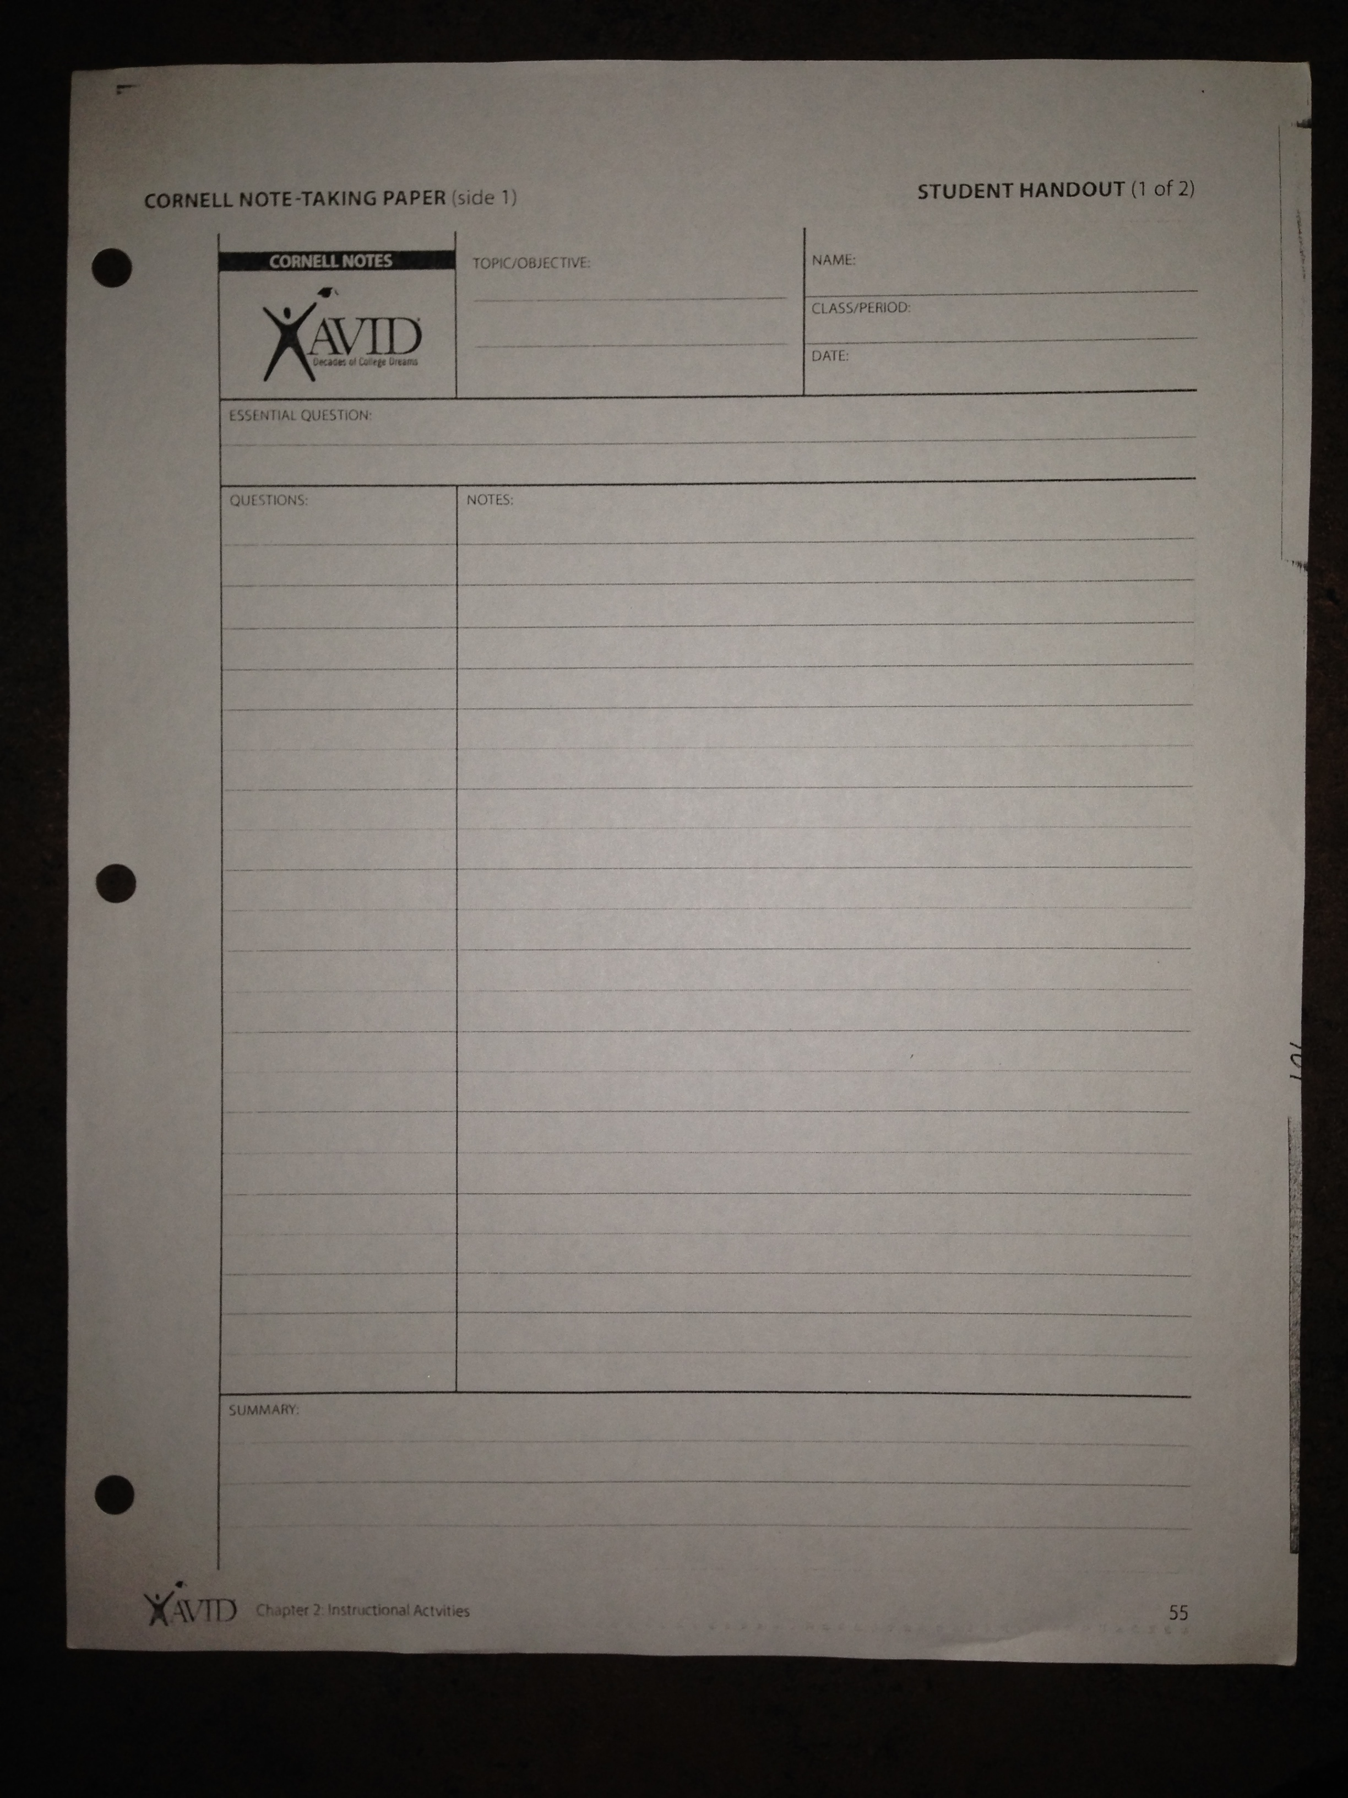
Cornell Notes…
Topic: Unit 1 Ratios
EQ: What is the relationship between a ratio and a fraction?
Don’t forget your name, period, and date!

Slide 7
Cornell Notes…
Notes:
A ratio is a comparison of two quantities using division. It says how much of one there is compared to another.
In a classroom with 12 girls and 16 boys, the ratio of girls to boys is 12 to 16.
12: 16 12 to 16 12/16

Slide 8
Cornell Notes…
Questions:
What are the different ways ratios can appear or be represented?
12: 16 12 to 16 12/16

Slide 9
Cornell Notes…
Notes:
A ratio is always a pair of numbers (non-negative numbers). The ORDER of the numbers matter!

Slide 10
Cornell Notes…
Notes:
Ratios appear in different ways:
* part-to-part
* part-to-whole
* whole-to-part
At the 6th grade dance, there are 132 boys, 89 girls, and 14 adults.

Slide 11
Cornell Notes…
Notes:
Part-to-part—
Ratio of number of boys to number of girls = ___________
Ratio of number of girls to number of boys = ___________
Ratio of boys to the number of teachers = _________
At the 6th grade dance, there are 132 boys, 89 girls, and 14 adults.

Slide 12
Cornell Notes…
Notes:
Part-to-whole—
Ratio of number of boys to the total number of people at the dance = _______________
At the 6th grade dance, there are 132 boys, 89 girls, and 14 adults.

Slide 13
Cornell Notes…
Notes:
Ratios are related to fractions.

Slide 14
A fraction is a number that names part of a whole or part of a group. The denominator represents the total number of equal parts the whole is divided into. A ratio is a comparison of two quantities. For example, in a group of five students in which there are 4 boys and 1 girl, the fraction of the group that is female is ____ . The fraction of the group that is male is ____. The denominator will always be five because the whole group consists of five students.
In the example given above, the ratio of girls to boys is _____ and the ratio of boys to girls is ______. The ratio of girls to students is _____ , and the ratio of boys to students is _____ .
Ratios depend on the numbers that are being compared. When you are describing a part of a whole, a fraction is appropriate. When you are comparing two numbers, a ratio is appropriate.

Slide 15
Another example is a juice drink that consists of 1 part juice to 3 parts water. The ratio of juice to water is _____ , but the fraction of the drink that is juice is ______ .

Slide 17
Essential Questions:
What is the relationship between a ratio and a fraction?

Slide 18
Learning Scale for Unit
NUMBER AND QUANTITY
Ratios and Unit Rates
Grade 6
Score 4.0 | In addition to score 3.0 performance, the student demonstrates in-depth inferences and applications that go beyond what was taught.
 | Score 3.5 | In addition to score 3.0 performance, partial success at score 4.0 content
Score 3.0 | The student will: Solve real-world and mathematical problems using ratios and unit rates (6.RP.A.3)
 | Score 2.5 | No major errors or omissions regarding score 2.0 content, and partial success at score 3.0 content
Score 2.0 | The student will recognize or recall specific vocabulary, such as: Equivalent, mathematical, quantity, rate, ratio, real world, relationship, representation, unit rate The student will perform basic processes, such as: Use ratio language to describe a ratio relationship between two quantities (6.RP.A.1) Use rate language in the context of a ratio relationship (6.RP.A.2) Recognize multiple equivalent representations of ratios (for example, 1:2, 1 to 2, 1/2)
 | Score 1.5 | Partial success at score 2.0 content, and major errors or omissions regarding score 3.0 content
Score 1.0 | With help, partial success at score 2.0 content and score 3.0 content
 | Score 0.5 | With help, partial success at score 2.0 content but not at score 3.0 content
Score 0.0 | Even with help, no success

Slide 19
Cornell Notes…
Notes:
Key words and phrases that indicate a ratio relationship:
to
for each
for every

Slide 20
Cornell Notes…
Notes:
We can use a table or diagram to display ratio relationships.
Ratio Table
# of boys # of girls Total # of players
4 1 5

Slide 21
Cornell Notes…
Notes:
We can use a table or diagram to display ratio relationships.
Tape Diagram

Slide 22
Cornell Notes…
Summary:
You can compare different quantities by using ratios. A ratio is a comparison of two quantities (#s of the same kind) using division. Ratios cannot be negative numbers. Ratios are related to fractions…

Slide 25
Reflections
What is the relationship between a ratio and a fraction?

Slide 26
Learning Logs
Write a ratio for the following description: Kaleel made three times as many baskets as John during basketball practice.
Describe a situation that could be modeled with the ratio 4:1.

Slide 27
Unit #1 Ratios
Continued
Equivalent Ratios

Slide 28
Learning Scale for Unit
NUMBER AND QUANTITY
Ratios and Unit Rates
Grade 6
Score 4.0 | In addition to score 3.0 performance, the student demonstrates in-depth inferences and applications that go beyond what was taught.
 | Score 3.5 | In addition to score 3.0 performance, partial success at score 4.0 content
Score 3.0 | The student will: Solve real-world and mathematical problems using ratios and unit rates (6.RP.A.3)
 | Score 2.5 | No major errors or omissions regarding score 2.0 content, and partial success at score 3.0 content
Score 2.0 | The student will recognize or recall specific vocabulary, such as: Equivalent, mathematical, quantity, rate, ratio, real world, relationship, representation, unit rate The student will perform basic processes, such as: Use ratio language to describe a ratio relationship between two quantities (6.RP.A.1) Use rate language in the context of a ratio relationship (6.RP.A.2) Recognize multiple equivalent representations of ratios (for example, 1:2, 1 to 2, 1/2)
 | Score 1.5 | Partial success at score 2.0 content, and major errors or omissions regarding score 3.0 content
Score 1.0 | With help, partial success at score 2.0 content and score 3.0 content
 | Score 0.5 | With help, partial success at score 2.0 content but not at score 3.0 content
Score 0.0 | Even with help, no success

Slide 29
Cornell Notes…
Topic: Unit 1 Ratios
Equivalent Ratios
EQ: When is it useful to be able to relate one quantity to another?

Slide 30
Cornell Notes…
Notes:
Ratios that name the same comparison are equivalent ratios.
You can find an equivalent ratio by multiplying or dividing both terms of a ratio by the same number.
12 12 x 2 = 24
14 14 x 2 = 28
Terms

Slide 32
Calculating Equivalent Ratios
Multiply the terms of the ratio by the same number.
Ex. ³/₄ · ²/₂ = Ex. ³/₄ · ³/₃ =
Divide the terms of the ratio by the same number.
Ex. ⁸/₁₂ ÷ ²/₂ = Ex. ⁸/₁₂ ÷ ⁴/₄ =

Slide 33
Ratios Group Work
Solve the following problems and check your answers with the fellow members of your group.
Instrument # of Instruments
Violins 18
Violas 8
Cellos 6
Double Basses 3
What is the ratio of the violas to the total instruments? Write the ratio 3 different ways.
⁸/₃₅, 8 to 35, 8: 35
Sofia completes ¾ of her passes. Mike completes 7 out of every 10 passes. Who has the better record?
¾ = 0.75 ⁷/₁₀ = 0.70
Sofia has a better record because 0.75 > 0.70.

Slide 34
Cornell Notes…
Summary:
Summarize your notes in one to two sentences using the words ratio, terms, and equivalent ratios.

Slide 35
Learning Scale for Unit
NUMBER AND QUANTITY
Ratios and Unit Rates
Grade 6
Score 4.0 | In addition to score 3.0 performance, the student demonstrates in-depth inferences and applications that go beyond what was taught.
 | Score 3.5 | In addition to score 3.0 performance, partial success at score 4.0 content
Score 3.0 | The student will: Solve real-world and mathematical problems using ratios and unit rates (6.RP.A.3)
 | Score 2.5 | No major errors or omissions regarding score 2.0 content, and partial success at score 3.0 content
Score 2.0 | The student will recognize or recall specific vocabulary, such as: Equivalent, mathematical, quantity, rate, ratio, real world, relationship, representation, unit rate The student will perform basic processes, such as: Use ratio language to describe a ratio relationship between two quantities (6.RP.A.1) Use rate language in the context of a ratio relationship (6.RP.A.2) Recognize multiple equivalent representations of ratios (for example, 1:2, 1 to 2, 1/2)
 | Score 1.5 | Partial success at score 2.0 content, and major errors or omissions regarding score 3.0 content
Score 1.0 | With help, partial success at score 2.0 content and score 3.0 content
 | Score 0.5 | With help, partial success at score 2.0 content but not at score 3.0 content
Score 0.0 | Even with help, no success

